Slide 1

Heart Disease Prediction
Team:
Anjana Ramegowda
Jafar Sharif Shaik
Ramya Vummaneni

Slide 2
Problem statement:
The leading cause of death in the developed countries is heart disease. Therefore there needs to be work done to help prevent the risks of having a heart attack or stroke

Slide 3
Dataset Summary
The dataset contains:
12 columns
981 rows
3 categorical columns
5 continuous columns
3 binary columns

Slide 4
Columns Info
Data Attributes
Age : patient age in years
Sex : M (male), F (female)
Cholestrol: serum cholesterol in mg/dl
FastingBS: fasting blood sugar > 120 mg/dl
(1 = true; 0 =False)
RestingECG: Resting electrocardiographic results
OldPeak:
ST depression induced by exercise relative to rest
HeartDisease:
1 = Heart Disease
0 = No Heart Disease
ChestPainType: chest pain types
1: typical angina
2: atypical angina
3: non-anginal pain
4: asymptomatic

Slide 5
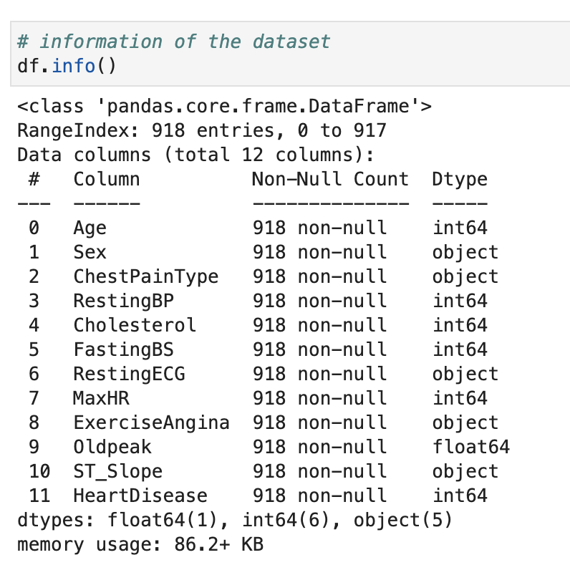
Dataset Information:

Slide 6
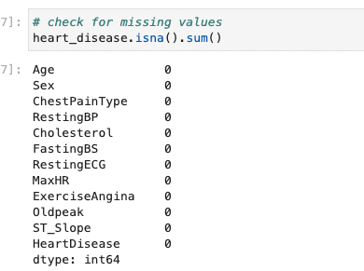
Missing Values: There are No missing values in the dataset

Slide 7
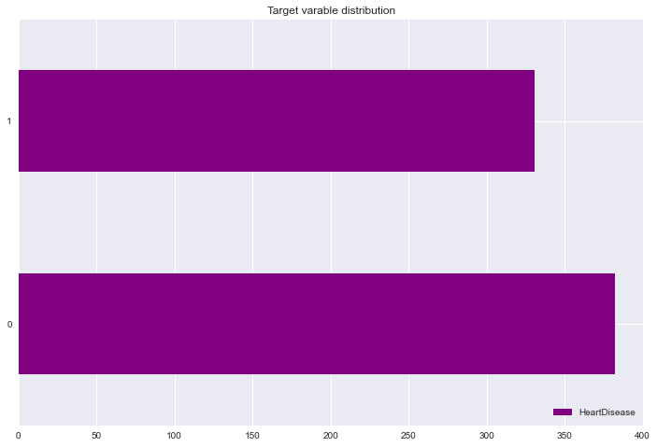
The Target Variable
In this context, the target variable is HeartDisease. Among the population, 382 individuals do not have a history of heart failure, while 331 individuals have experienced heart failure.

Slide 8
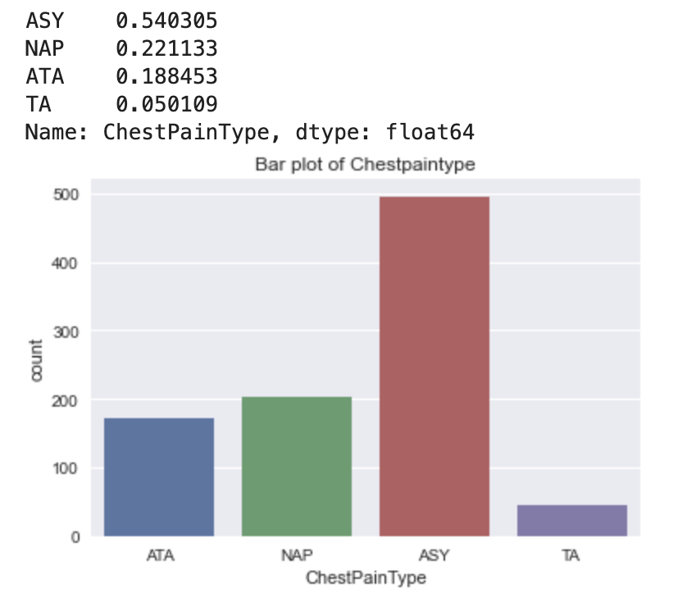
Exploratory Data Analysis of Categorical Variables
Chest pain is described in these 4 types and here are the frequency distribution values

Slide 9
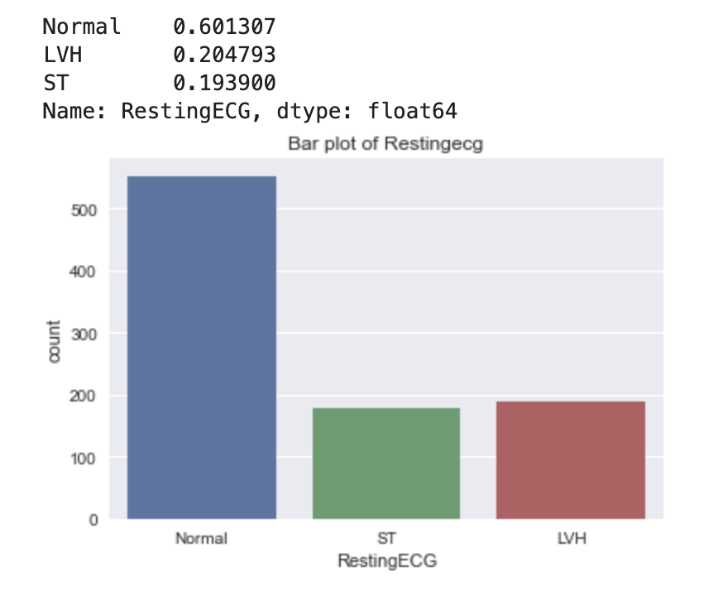
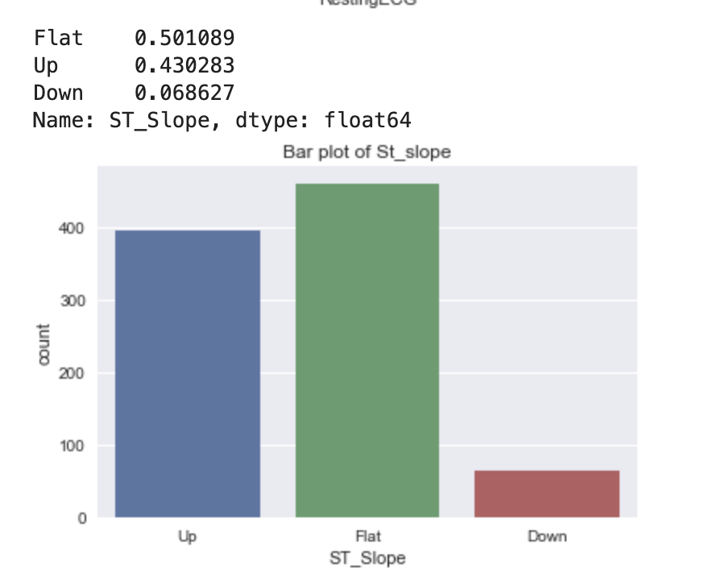
ST slope also has 3 categories
Resting ECG has 3 categories with frequency range from 0.19-0.60

Slide 10
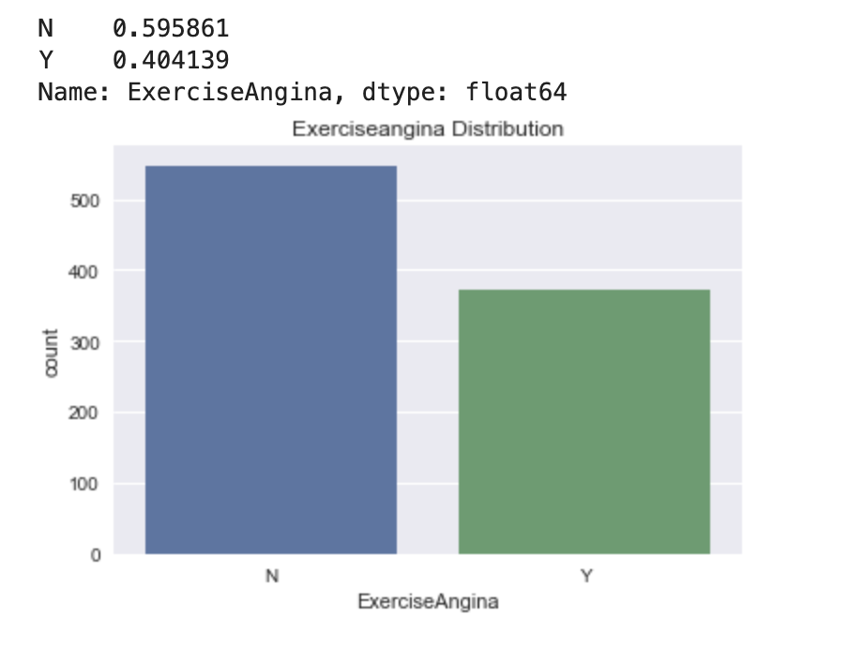
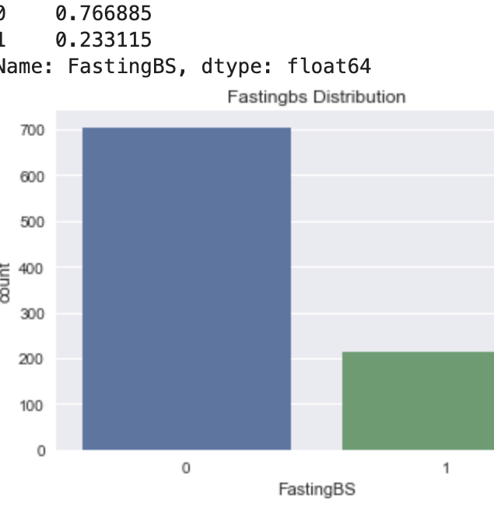
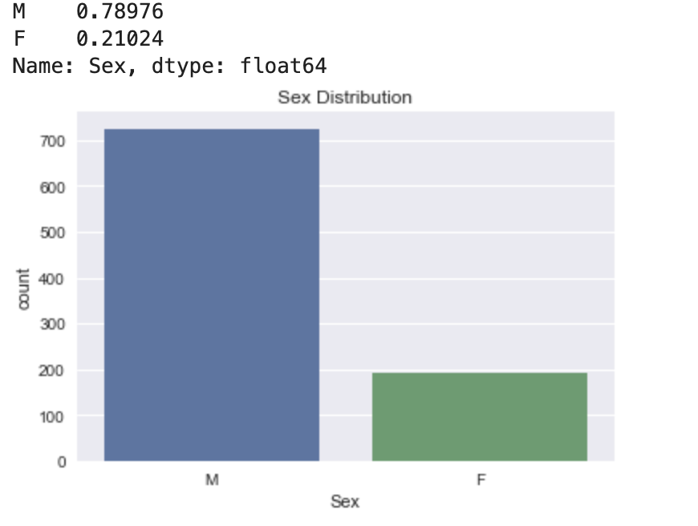
Exploratory Data Analysis for binary variables

Slide 11
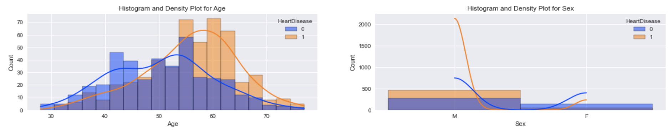
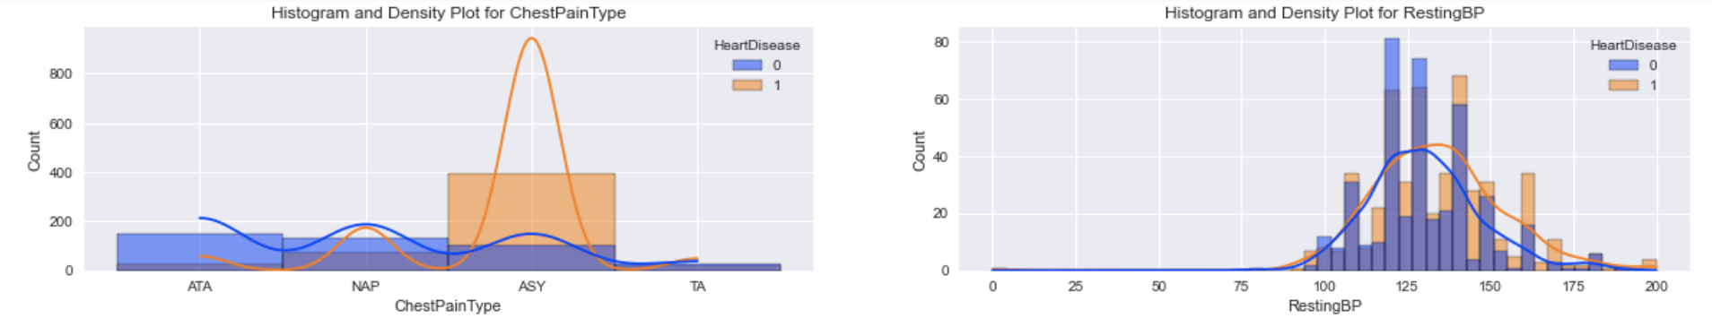
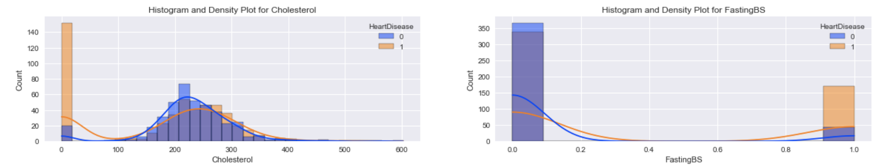
Exploratory data analysis of variables against target variable

Slide 12
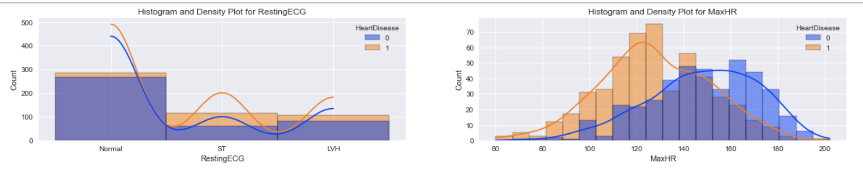
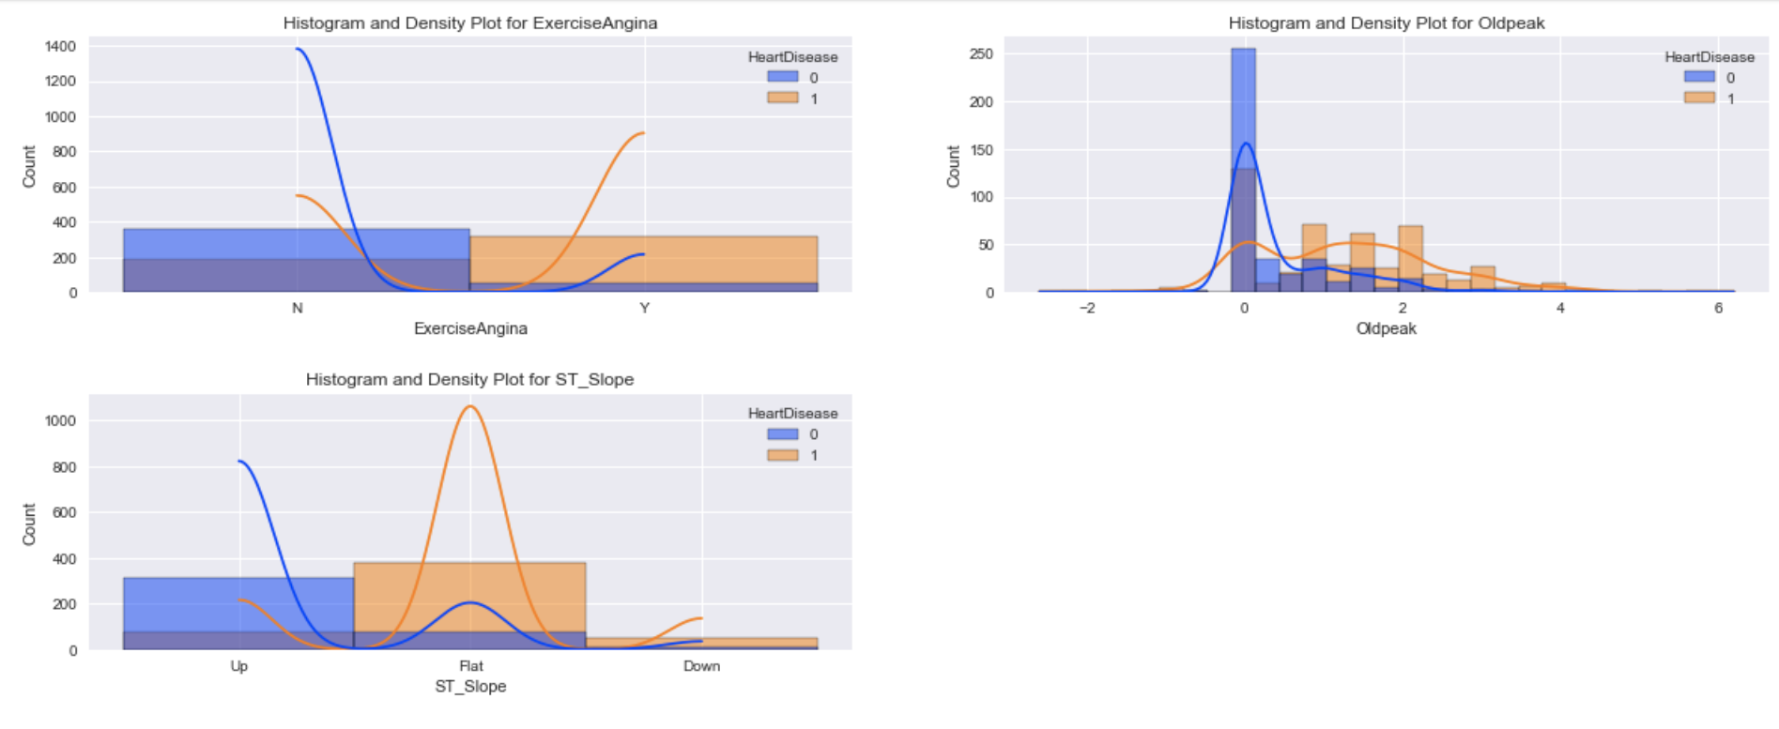

Slide 13
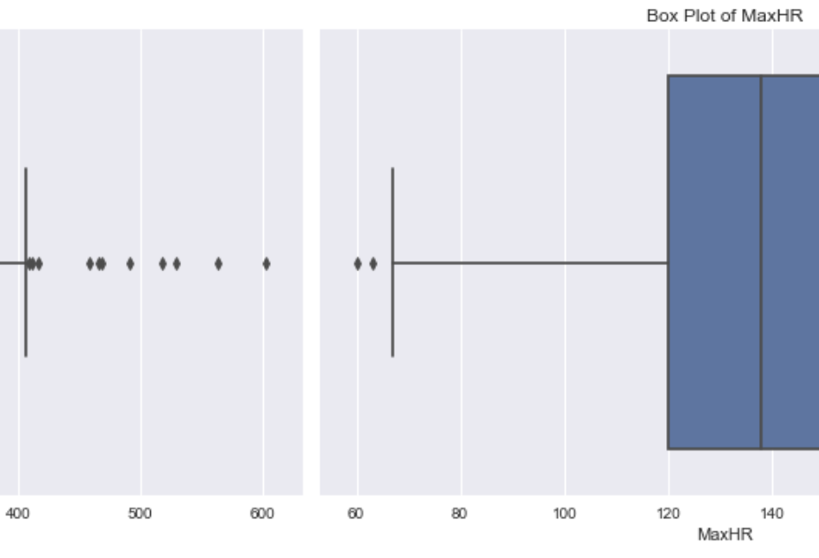
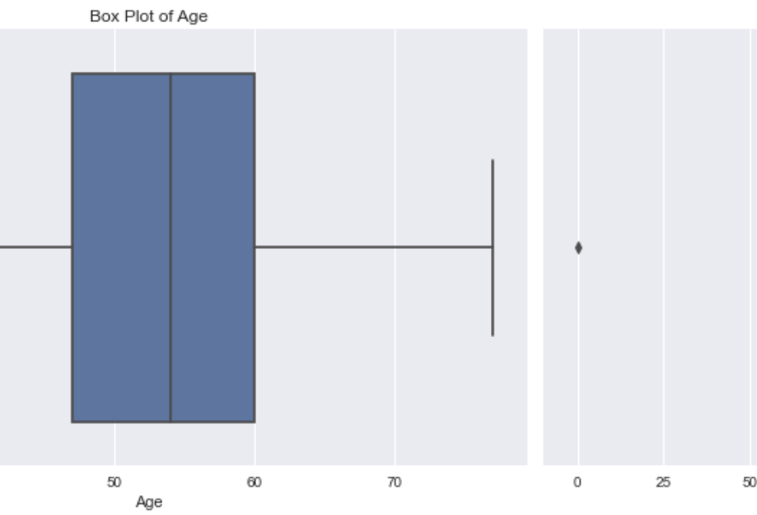
Leveraged Box plots to find outliers

Slide 14
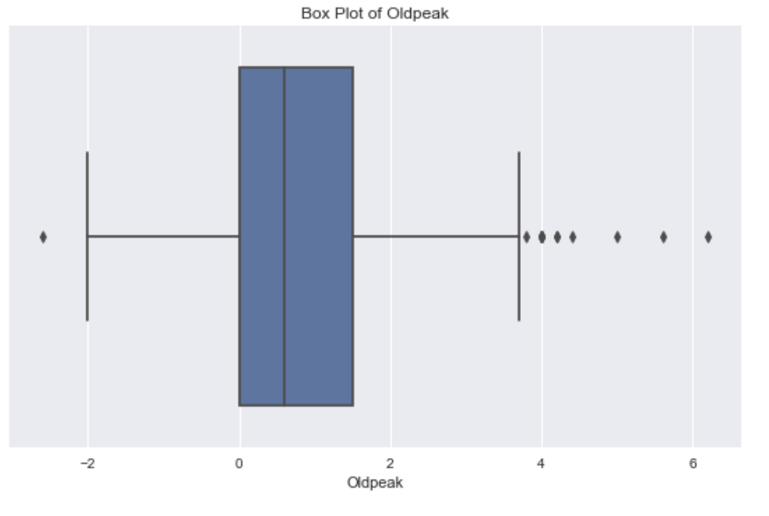
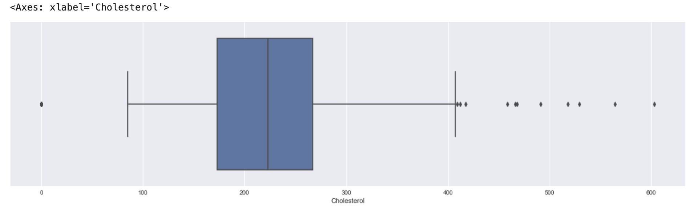

Slide 15
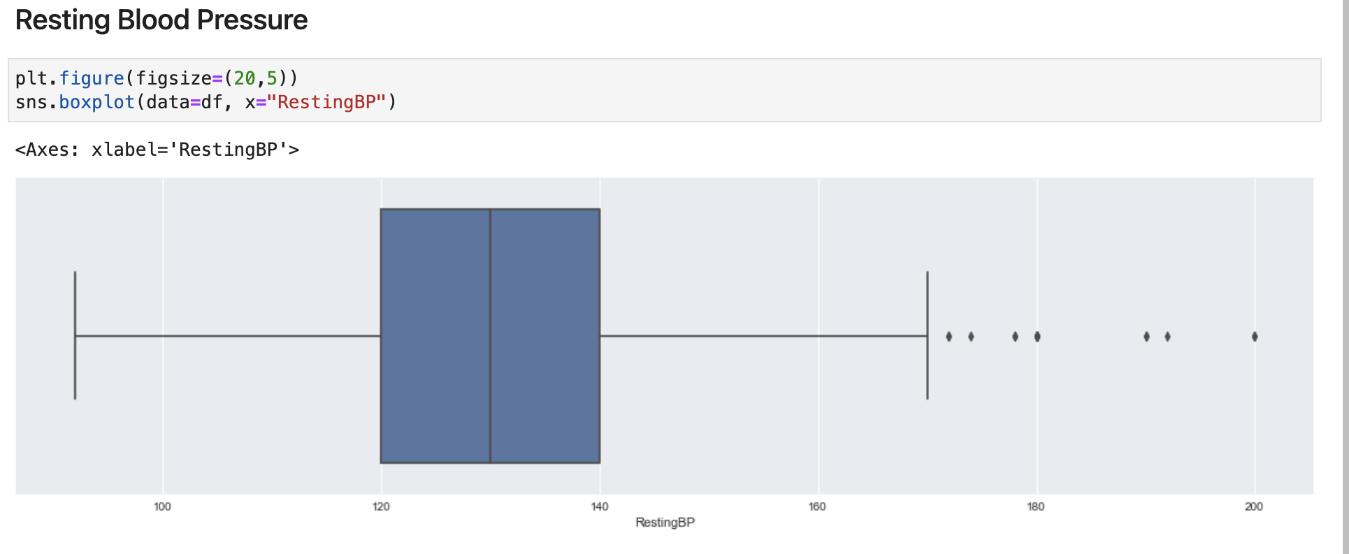

Slide 16
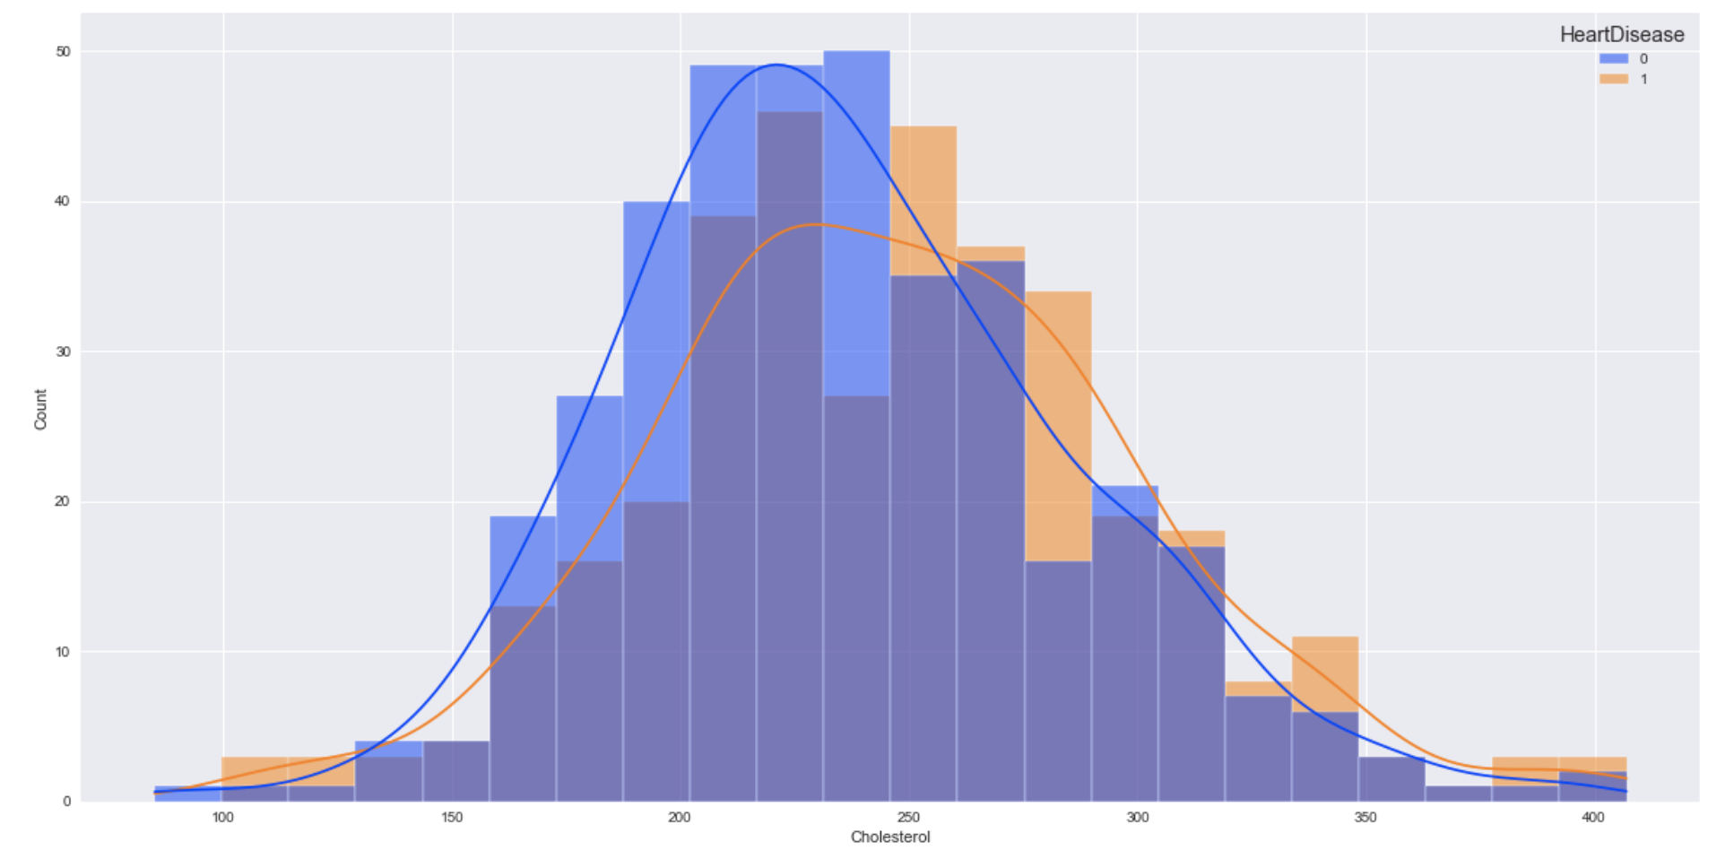

Slide 17
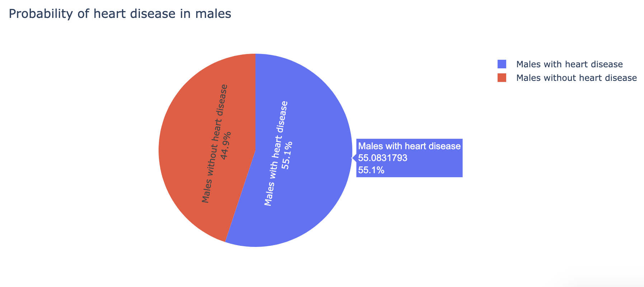

Slide 18
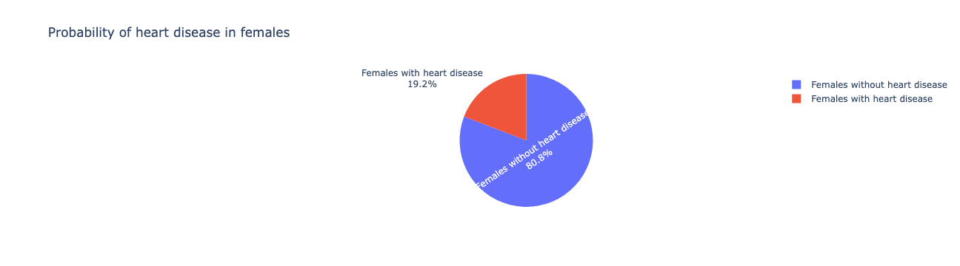

Slide 19
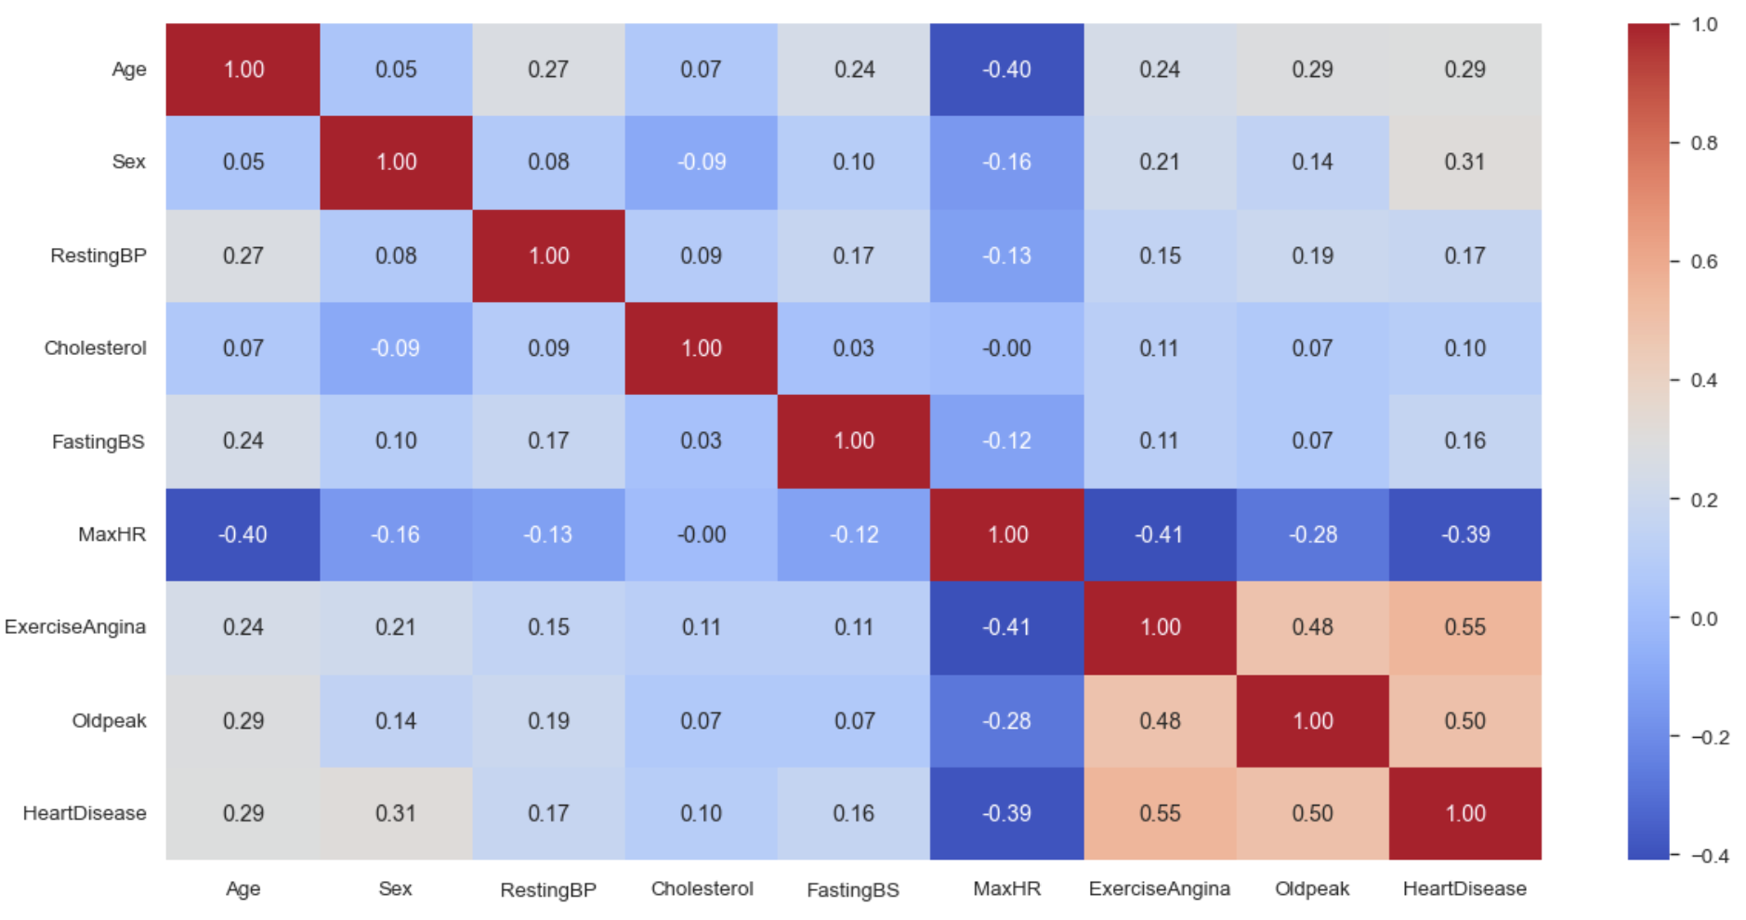
Correlation Matrix

Slide 20
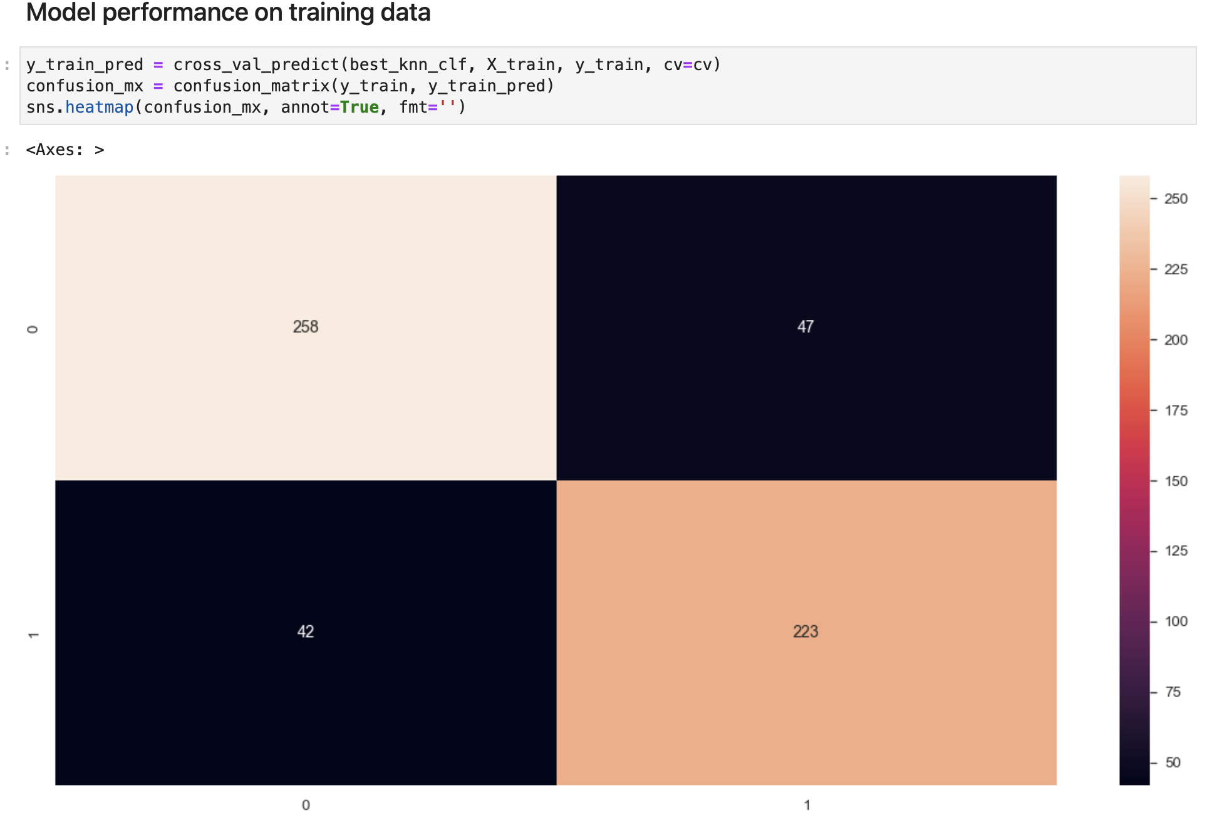
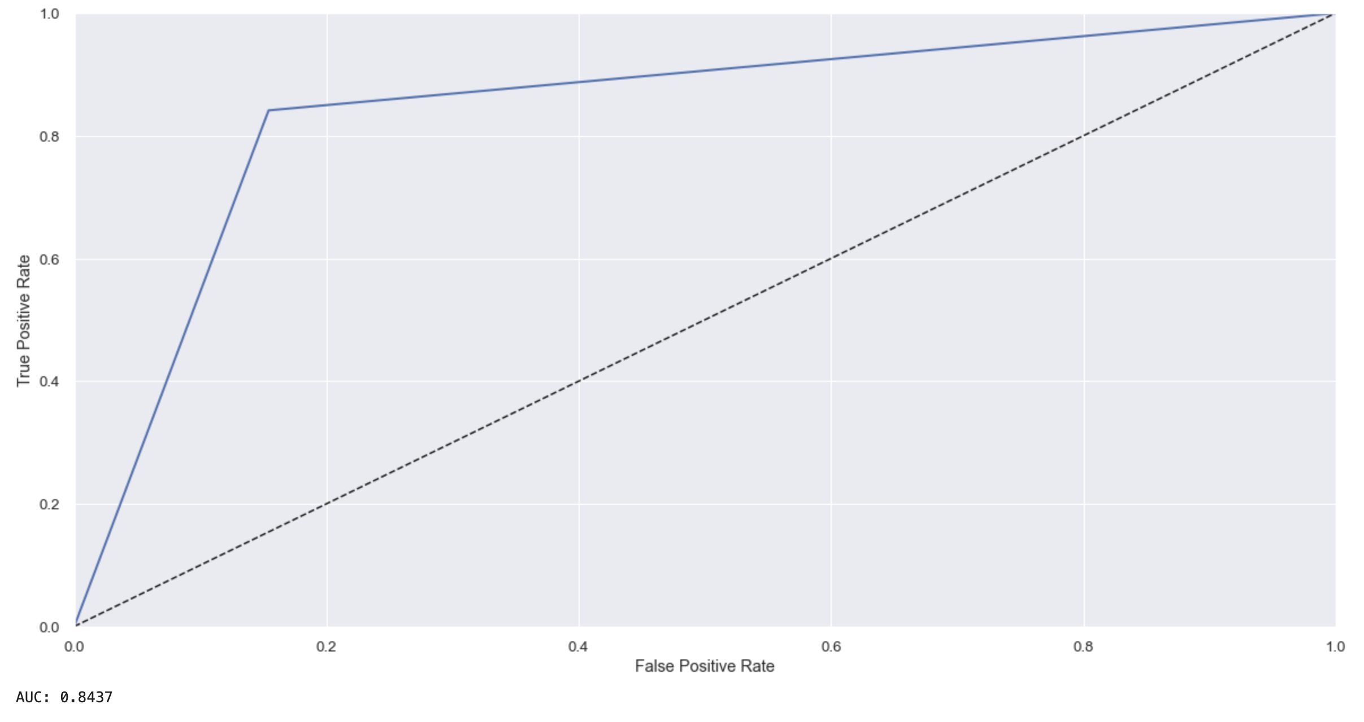
K-Nearest Neighbors Classifier
A non-parametric, Supervised learning classifier, which uses proximity to make classifications about
grouping of an individual data point.
AUC for prediction on training data : 0.8437

Slide 21
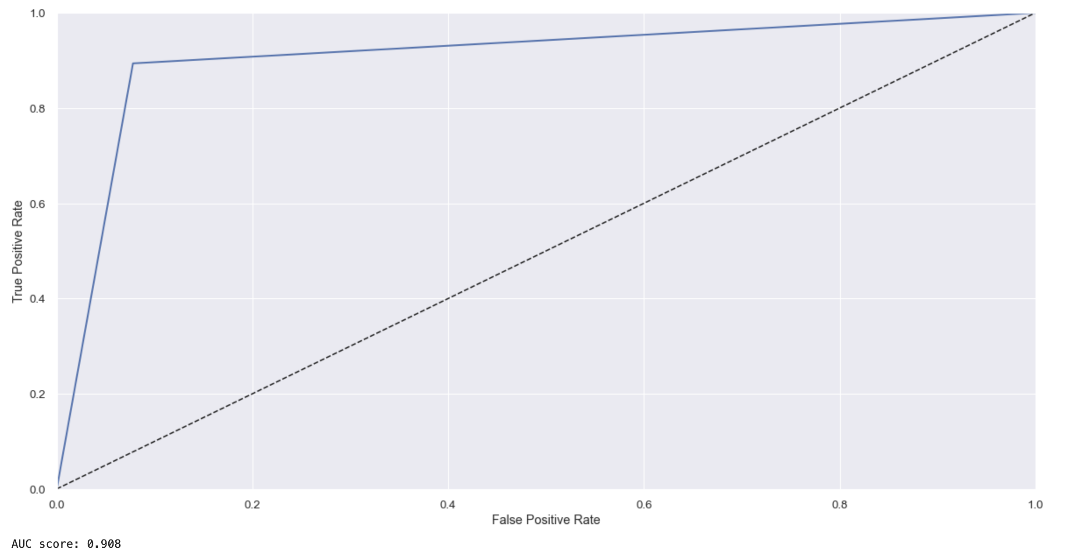
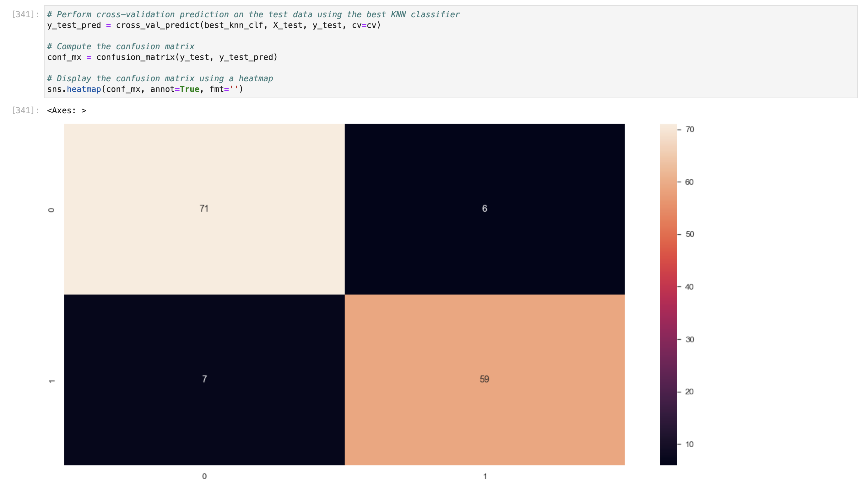
K-Nearest Neighbors Classifier On Test Data
Is sensitive to the scale of the input features
Performs better on data with low dimensionality.
AUC for prediction on test dataset : 0.908

Slide 22
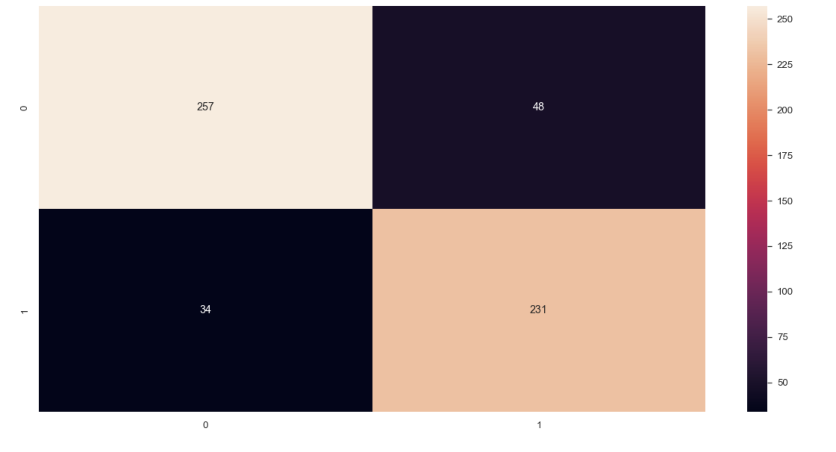
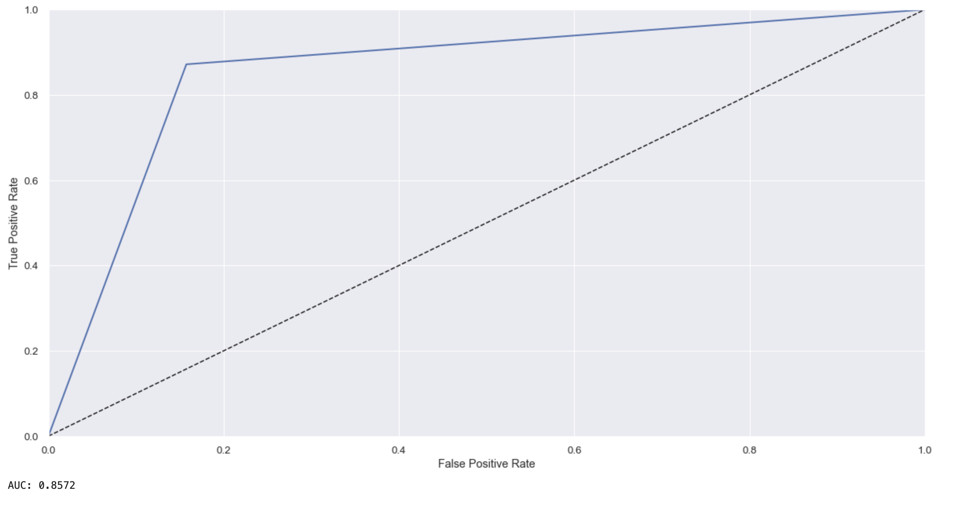
Support Vector Machine Classifier
Supervised learning ML algorithm used for classification and regression challenges.
Each feature values represent a coordinate. Optimal hyper-plane used for classification.
AUC for prediction on training data : 0.8572

Slide 23
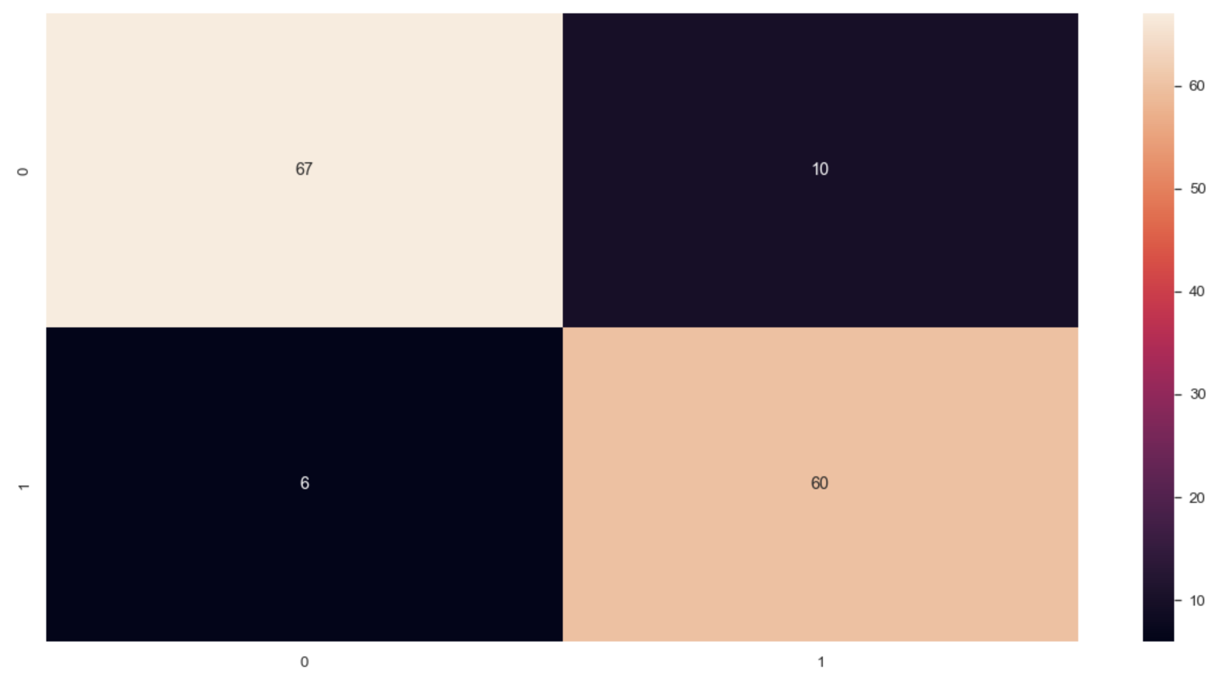
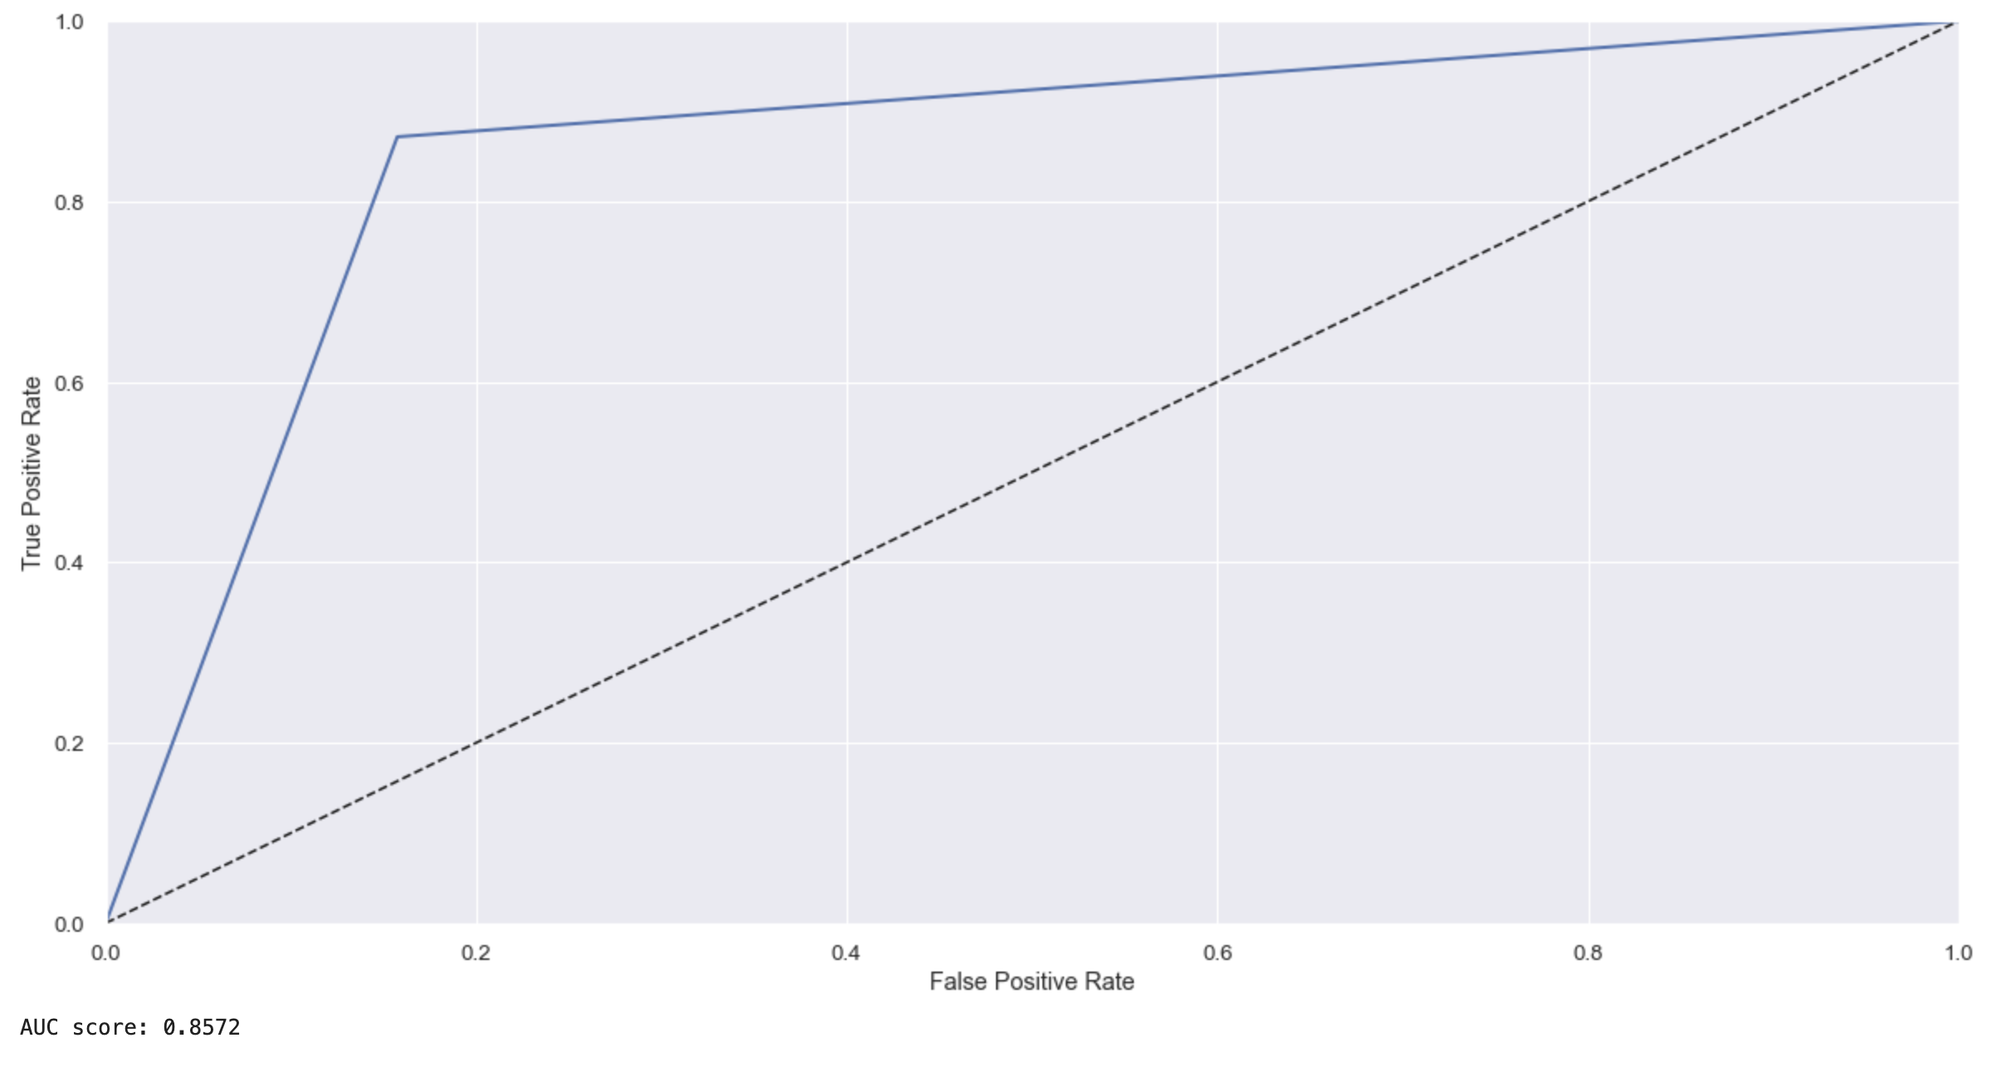
Support Vector Machine Classifier on Test Data
SVM can handle high-dimensional data. Most used in medical applications where no of features is large.
AUC for prediction on test dataset : 0.8896

Slide 24
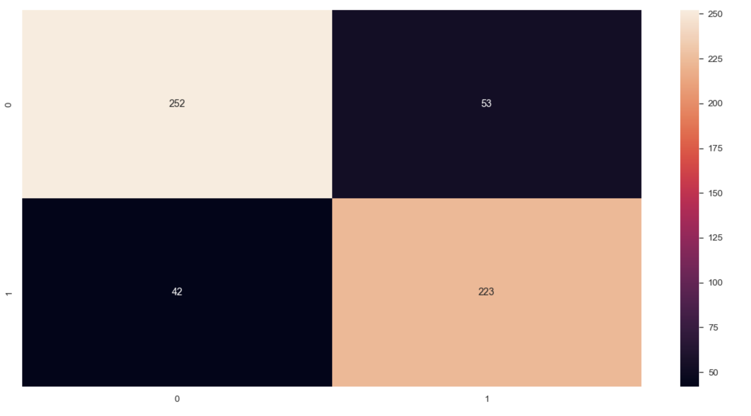
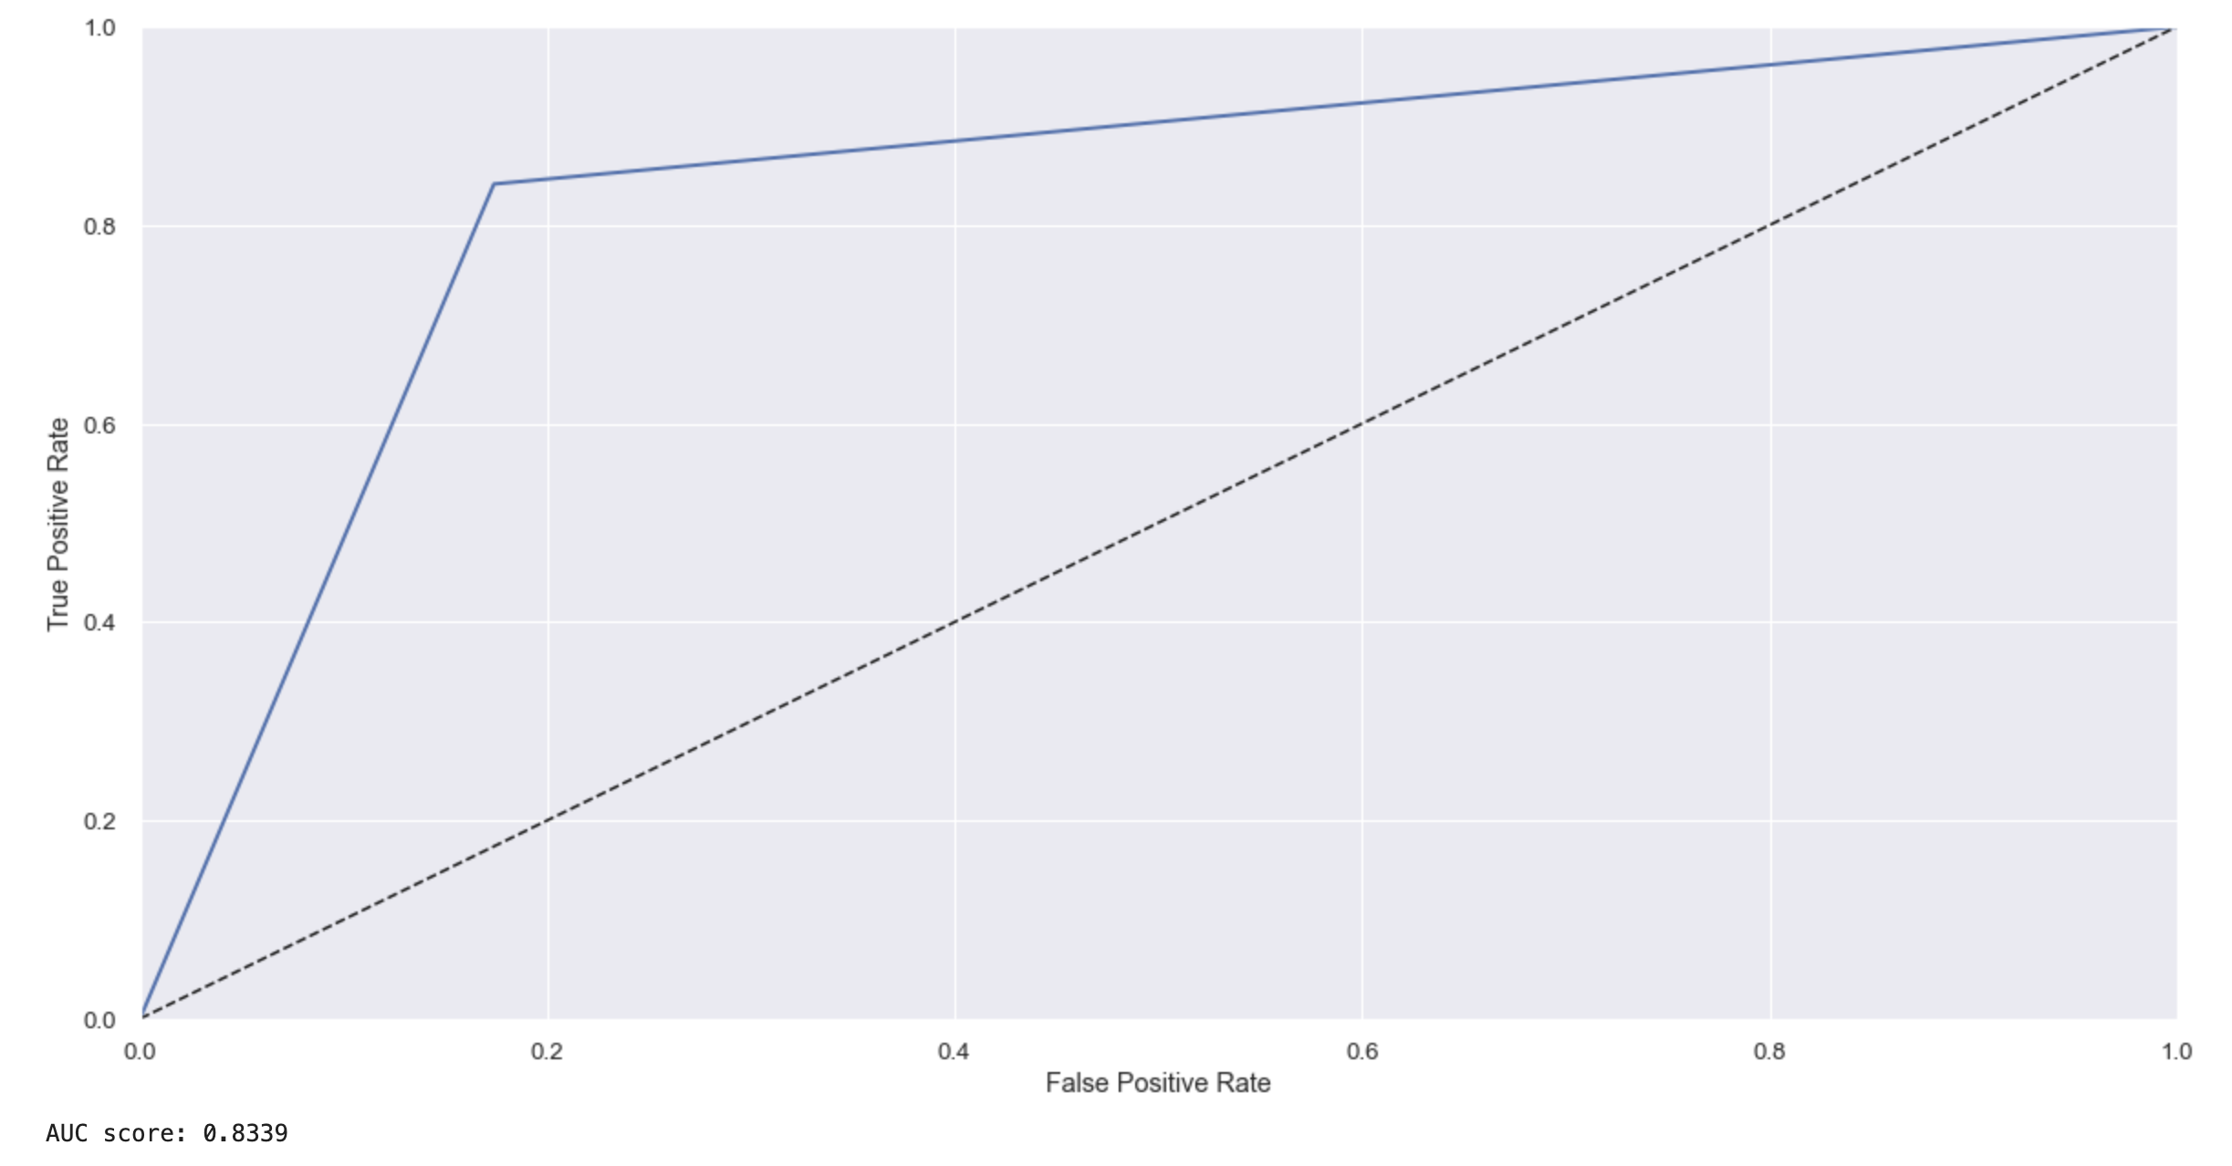
Random Forest Classifier
Supervised learning algorithm with the ensemble learning method.
Ensemble learning method combines predictions from multiple models.
Results in more accurate prediction than a single model.
AUC for prediction on training data : 0.8339

Slide 25
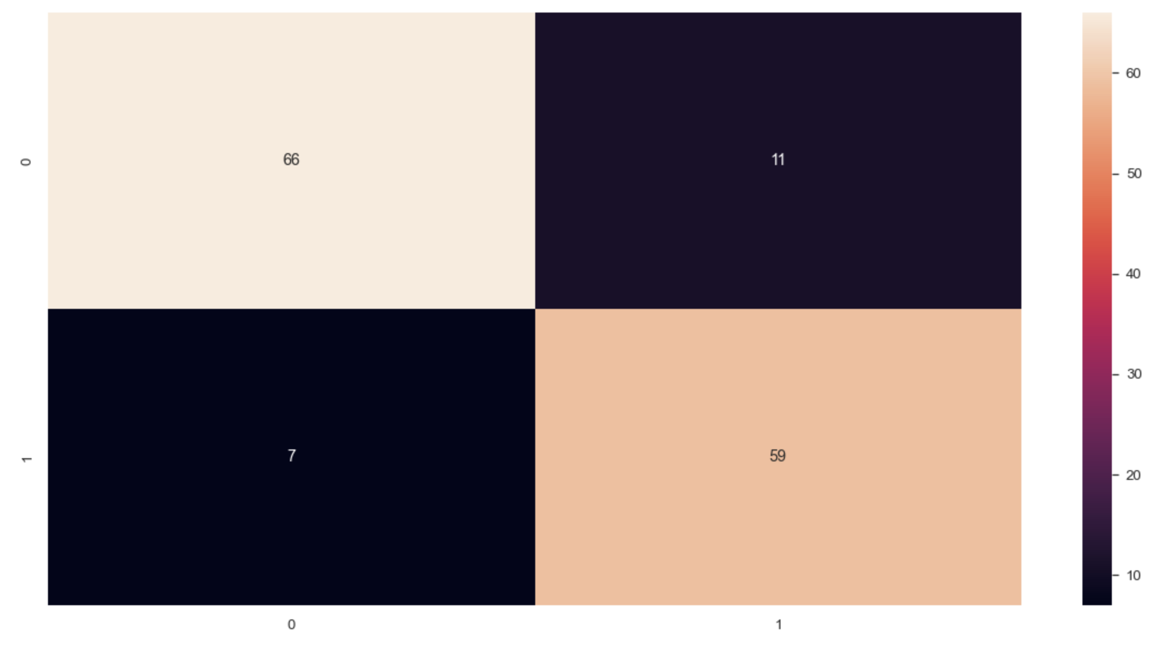
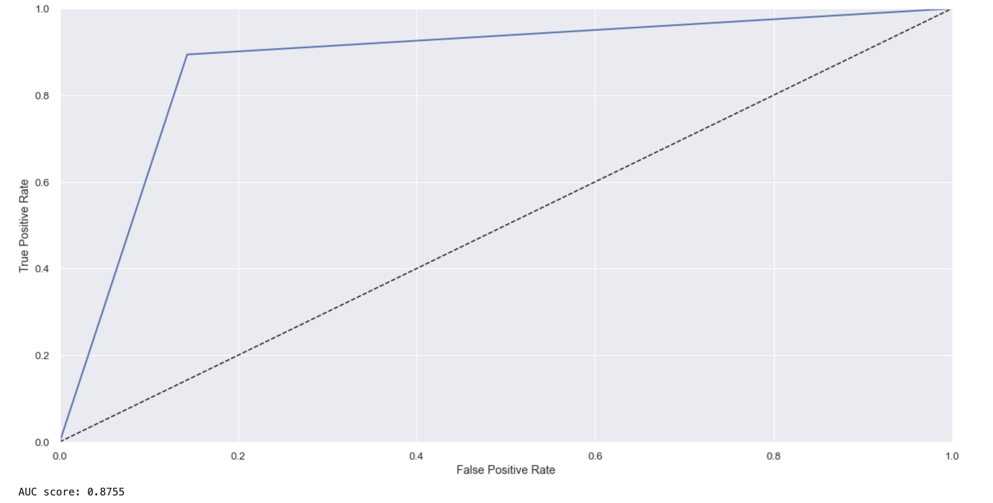
Random Forest on Test Data
Can handle high-dimensional data and noisy data.
Can be computationally expensive to build and train.
AUC for prediction on test dataset : 0.8755

Slide 26
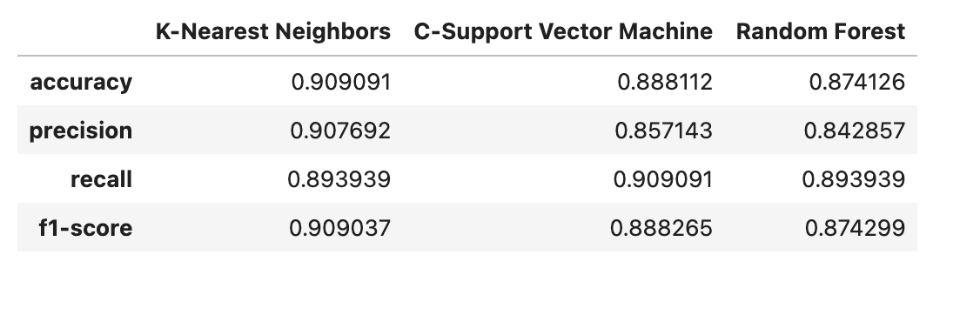

Slide 27
Conclusion
K-Nearest Neighbors algorithm had the highest accuracy, precision, recall, and f1-score.
C-Support Vector Machine algorithm closely followed K-Nearest Neighbors
Random Forest algorithm had slightly lower performance in terms of evaluation metrics
Further analysis needed to determine the best algorithm for specific task, considering factors
such as computational efficiency and interpretability.

Slide 28

Thank you

